Slide 1

Ocular Surface Disease (OSD) Presentation Master Deck
Version 1.0
Date of preparation: November 2025 | NP-GLAU-Asia-0132
Developed with support from:

Slide 2
Master Deck guidance
This slide deck is intended to be a library of slides around OSD epidemiology, etiology and management in the context of glaucoma
You may choose slides in this deck and adapt them according to your presentation needs
Template slides for presenting patient cases are provided at the end of this slide deck, should case presentations be required
This master deck has been approved at the regional level. Local approval may be required, depending on your respective country’s regulations
OSD: ocular surface disease.

Slide 3
1
Epidemiology and Etiology of OSD

Slide 4
Section summary
1
OSD is common especially in moderate-to-severe glaucoma patients^{1,2}
2
Preservatives can damage the ocular surface and TM, leading to a vicious cycle of OSD and inflammation^{3–5}
3
OSD is not just a tolerability issue; it contributes to uncontrolled IOP through
medication non-adherence and inflammation^{5,6}
4
Pre-surgical exposure to preservatives is a risk factor for trabeculectomy failure⁷
PF: preservative-free; OSD: ocular surface disease; TM: trabecular meshwork.
1. Sarimiye TF, et al. JOECSA 2020;19(1):34–8; 2. Skalicky SE, et al. Am J Ophthalmol 2012;153(1):1–9.e2. 3. Zhou A, et al Ophthalmol Ther 2022;11:1681–704; 4. Fineide F, et al. Ocular Surf 2022;26:19–49; 5. Baudouin C, et al. Prog Retin Eye Res 2021;83:100916;
6. Bloomenstein M, et al. Modern Optometry 2024;July/August:51–3; 7. Boimer C, et al. J Glaucoma 2013;22(9):730–5.

Slide 5
OSD is common in glaucoma patients
OSD prevalence in glaucoma patients
according to glaucoma severity
P<0.01
OSD is more common in moderate-to-severe glaucoma
Higher OSD prevalence is associated with:
    Increasing glaucoma severity
    Higher exposure to preservatives
Patients with OSD (%)
Adapted from Sarimiye TF, et al. 2020.
OSD: ocular surface disease.
Sarimiye TF, et al. JOECSA 2020;19(1):34–8.

Slide 6
OSD severity increases with glaucoma severity
OSDI score in glaucoma patients
according to glaucoma severity
P<0.001
OSDI increases significantly with
increasing glaucoma severity
Higher OSDI scores are associated with:
    Higher exposure to preservatives
    Poorer glaucoma-related QoL
Mean OSDI score
Adapted from Skalicky SE, et al. 2012.
OSD: ocular surface disease; OSDI: ocular surface disease index; QoL: quality of life.
Skalicky SE, et al. Am J Ophthalmol 2012;153(1):1–9.e2.

Slide 7
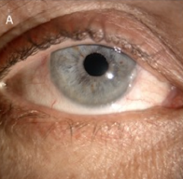
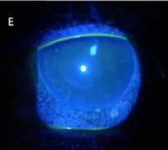
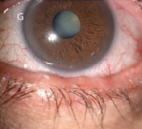
Anti-glaucoma medications contain ingredients that may induce OSD
The causes of OSD are multifactorial, leading to allergic, toxic or pro-inflammatory conditions¹
These can be attributed to:
Active ingredients in anti-glaucoma drugs^{1–3}
Toxicity of preservatives^{1–3}
Additives and excipients which can be found
in preservative-free formulations, such as
MGHS 40 (in vitro and ex vivo data)^{4,5}
Ocular surface changes induced by
preserved glaucoma medications²:
Mild to moderate conjunctival hyperemia and vessel congestion
CFS showing an irregular distribution of the tear film
Irregularity of
lower eyelid
CFS: corneal fluorescein staining; MGHS 40: macrogolglycerol hydroxystearate 40; OSD: ocular surface disease.
1. Stewart WC, et al. Curr Eye Res 2011;36(5):391–98; 2. Zhang X, et al. Eye Contact Lens 2019;45(1):11–8;
3. Zhou A, et al Ophthalmol Ther 2022;11:1681–704; 4. Panfil C, et al. Ophthalmol Ther 2023;12(5):2641–55;
5. Smedowski A, et al. J Biochem Pharmacol Res 2014;2(4):175–84.

Slide 8


Preservatives in anti-glaucoma medications cause damage to the ocular surface
Antimicrobial detergent properties of BAK also:^{1,2}
Active
molecules
+ BAK
Damage to
Tear Film
  Destroy film lipid layer^{1–4}
  Shorten TBUT and decrease tear film stability^{1–3}
Damage to Cornea
  Reduce corneal epithelial cell viability, increase apoptosis^{1–3}
  Induce/enhance inflammatory response^{1–4}
  Impair cell proliferation¹
Damage to Conjunctiva
  Induce subconjunctival fibrosis¹
  Induce conjunctival epithelial toxicity^{1–4}
  Reduce goblet cell density,^{1–4} impair mucin production^{1,2}
Most frequently used preservative:
Benzalkonium chloride (BAK)
  Concentration: 0.004–0.02%^{1,2}
BAK: benzalkonium chloride; OSD: ocular surface disease; TBUT: tear film break-up time.
1. Zhou A, et al. Ophthalmol Ther 2022;11:1681–704; 2. Fineide F, et al. Ocular Surf 2022;26:19–49; 3. Figus M, et al. Expert Opin Drug Deliv 2021;18:655–72; 4. Konstas AG, et al. Expert Opin Drug Saf 2021;20:453–66; 5. Cela D, et al. J Fr Ophtalmol 2021;44:e497–e517.

Slide 9
Preservatives in PGAs are associated with ocular surface damage
Results of 12 months follow-up between PC PGA and PF PGA
PC PGA (n=42)
PF PGA (n=38)
Meibo Score (%)
LAS (0–4)
*
PGAs are associated with higher prevalence and severity of obstructive MGD than non-PGAs¹
Patients on PC PGAs showed significantly worse meibomian gland parameters, greater OSS scores and shorter TBUT vs patients on PF PGAs²
*
OSS (0–5)
TBUT (seconds)
*
*
*P<0.05
Adapted from Ha JY, et al. 2019.
BAK: benzalkonium chloride; LAS: lid margin abnormality score; MGD: meibomian gland dysfunction; OSS: ocular surface staining; PC: preservative-containing; PF: preservative-free; PGA: prostaglandin analog; TBUT: tear film break-up time.
1. Mocan MC, et al. J Glaucoma 2016;25(9):770–4; 2. Ha JY, et al. Chonnam Med J 2019;55:156–62.

Slide 10
Preservatives are associated with inflammation
Expression of inflammatory marker HLA-DR in conjunctiva epithelium
** §
** §
Higher levels of HLA DR and inflammatory cytokines (IL-6, IL-8) are associated with:
    Preserved treatment
    Multiple glaucoma treatments
HLA expression (%)
Control (untreated)
Non-preserved
Preserved
Multiple treatments
**P<0.001 vs control group
§P≤0.03 vs non-preserved group
Adapted from Baudouin C, et al. 2004.
HLA-DR: human leukocyte antigen-DR; IL: interleukin; OSD: ocular surface disease; TGF-β1, transforming growth factor beta 1.
Baudouin C, et al. Ophthalmology 2004;111:2186–92; 2.

Slide 11
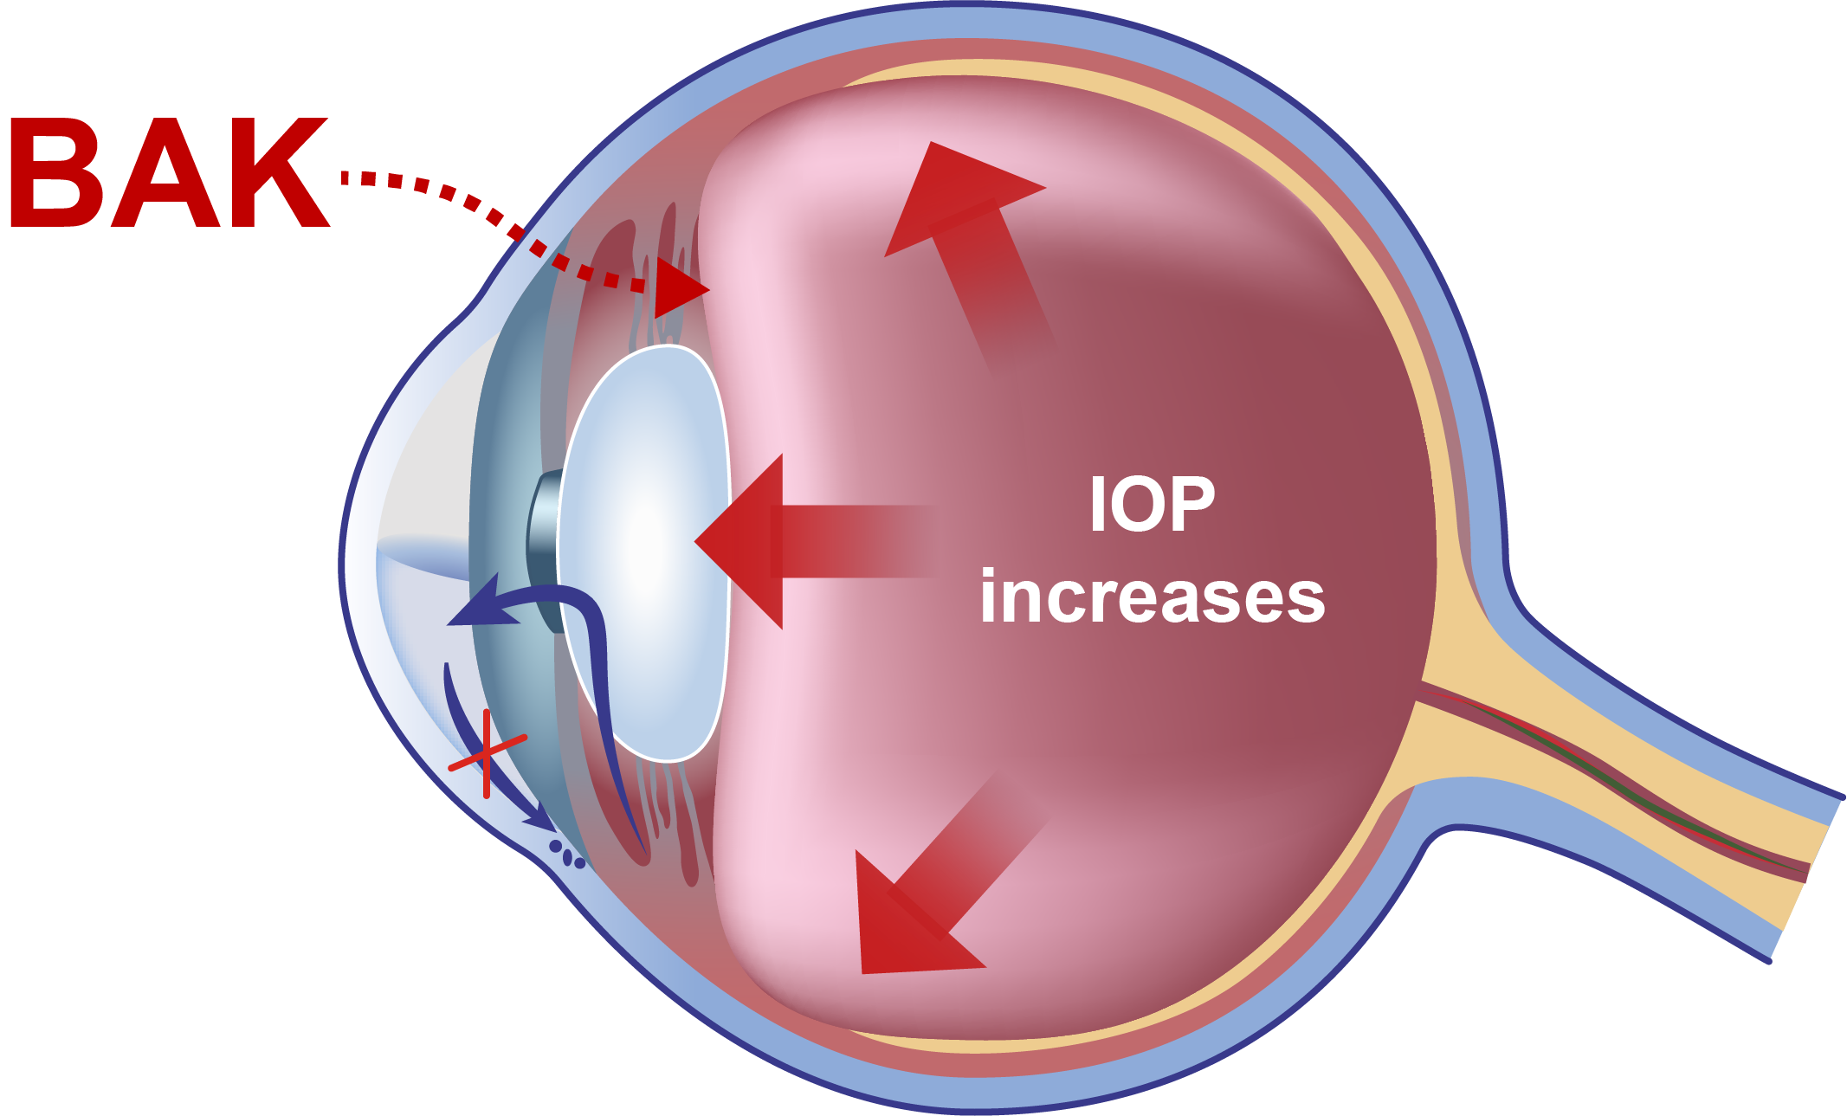
Preservatives damage the trabecular meshwork
1
Preservative penetrates deeper into the eye (rabbit model)
Demonstrated effects of BAK
on the TM (in vitro)
Cell death, DNA fragmentation, and gene expression alterations in TM cell culture
Generation of inflammatory mediators (e.g. CX3CL1/fractalkine)
Decreased expression of protective chemokines (SDF-1, CXCL12)
2
Trabecular meshwork becomes inflamed
3
Aqueous humour flow is impeded (rat model)
Progressive TM cell loss
BAK: benzalkonium chloride; CX3CL1: C-X3-C motif chemokine ligand 1; CXCL12: C-X-C motif chemokine ligand 12;
IOP: intraocular pressure; SDF-1: stromal cell-derived factor 1; TM: trabecular meshwork.
Baudouin C, et al. Prog Retin Eye Res 2021;83:100916. ​

Slide 12
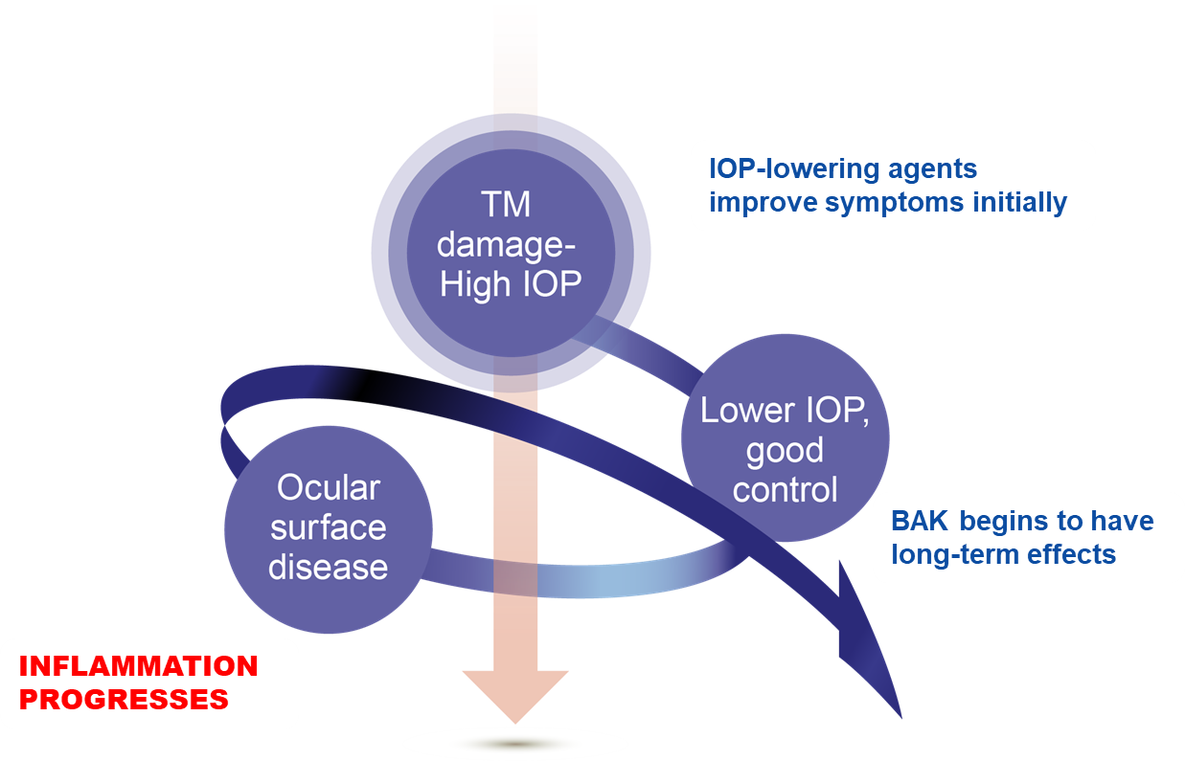
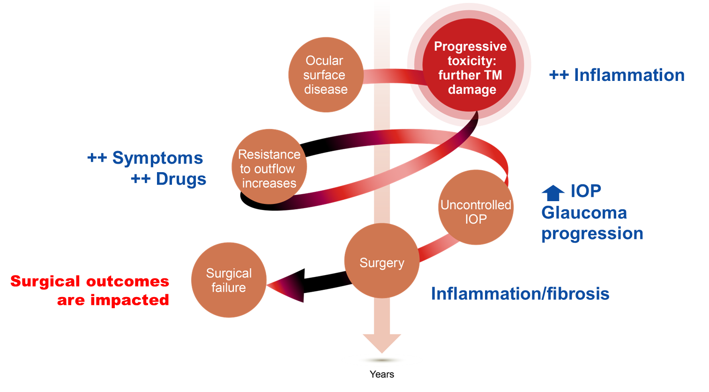
The vicious cycle of preservative damage
TM damage begins
TM damage continues
Adapted from Baudouin C, et al. 2021.
BAK: benzalkonium chloride; IOP: intraocular pressure; TM: trabecular meshwork.
Baudouin C, et al. Prog Retin Eye Res 2021;83:100916. ​

Slide 13
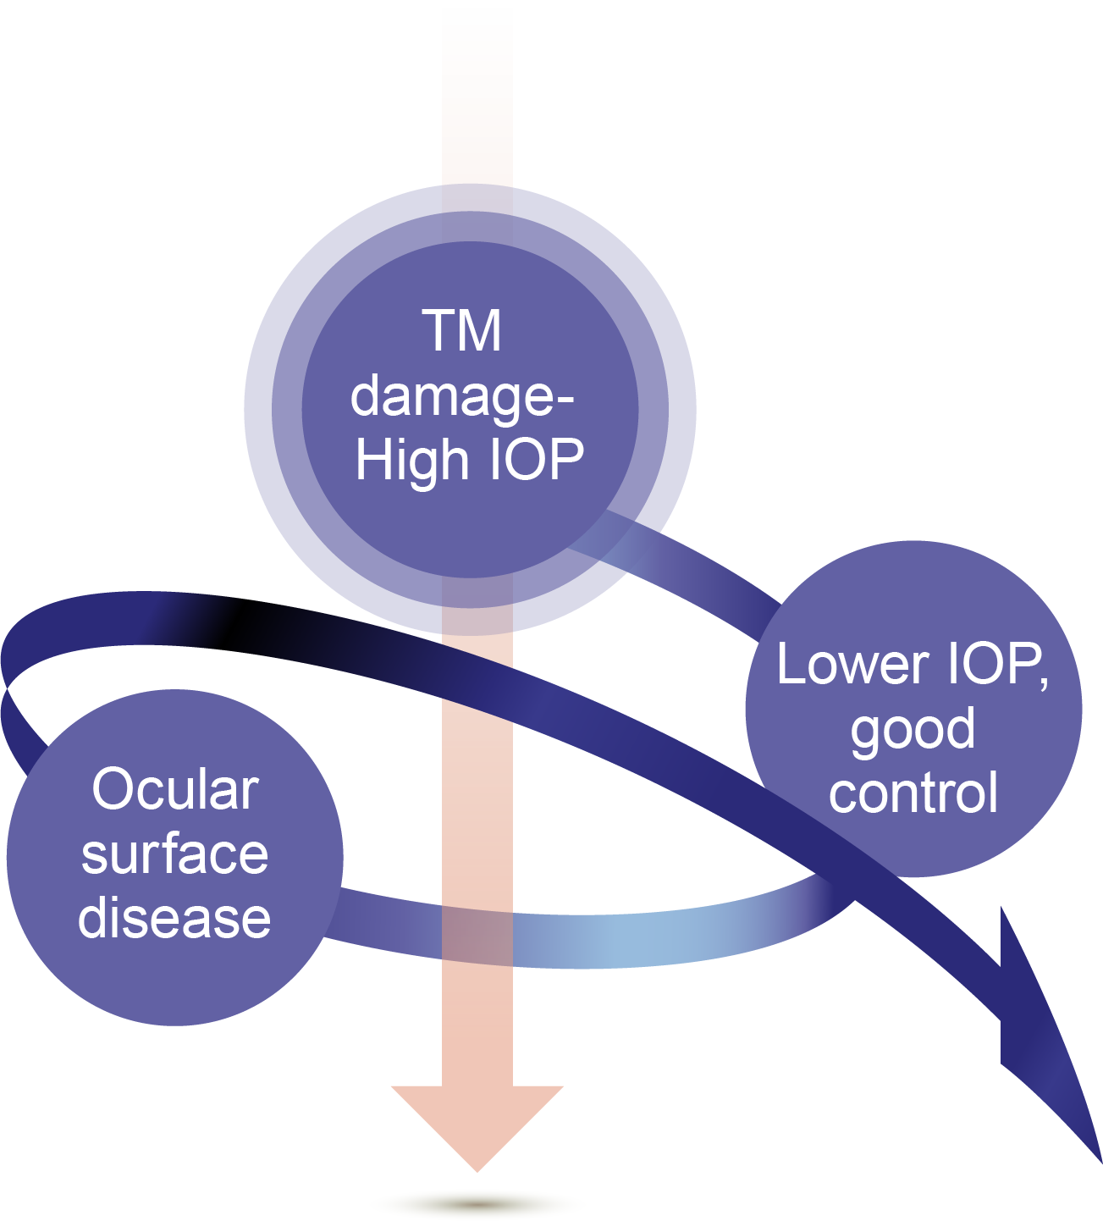
Preservative damage: The vicious cycle begins
TM damage begins
IOP-lowering agents improve symptoms initially
Preservatives in eye drops induce inflammation
Inflammation could damage the cornea and TM, causing OSD^{1,2}
BAK begins to have long-term effects
INFLAMMATION
PROGRESSES
Adapted from Baudouin C, et al. 2021.
BAK: benzalkonium chloride; IOP: intraocular pressure; OHT: ocular hypertension; POAG: primary open-angle glaucoma;
TM: trabecular meshwork.
1. ​Baudouin C, et al. Prog Retin Eye Res 2021;83:100916; 2. Baudouin C, et al. Ophthalmology 2004;111:2186–92.

Slide 14
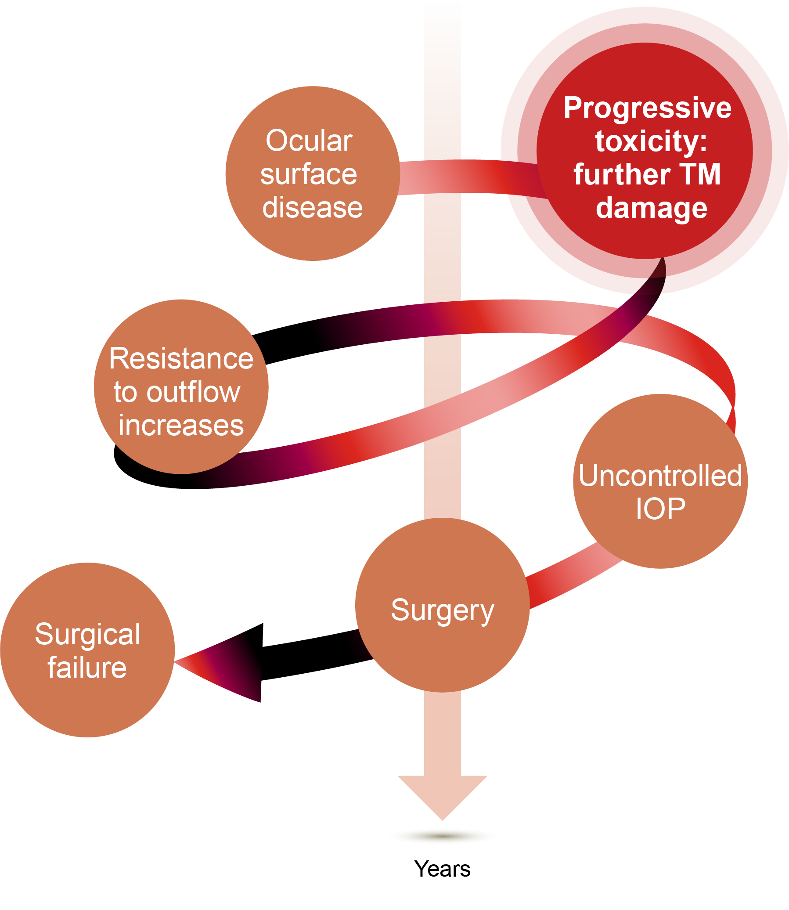
Preservative damage: The vicious cycle continues
++ Inflammation
BAK penetrates deeper into ocular tissues (rabbit model)
Leading to TM cell death (in vitro), reduced AH outflow and increased IOP (rat model)
++ Inflammation
++ Symptoms
++ Drugs
IOP
Glaucoma
progression
Surgical outcomes are impacted
Inflammation/fibrosis
Adapted from Baudouin C, et al. 2021.
AH: aqueous humor; BAK: benzalkonium chloride; IOP: intraocular pressure; OSD: ocular surface disease; TM: trabecular meshwork.
Baudouin C, et al. Prog Retin Eye Res 2021;83:100916.

Slide 15
Preservative damage: The vicious cycle continues
++ Inflammation
++ Inflammation
++ Symptoms
++ Drugs
Reduced long-term efficacy of IOP-lowering agents^{1–3}
Post-operative fibrosis and scarring^{1,4}
Exaggerated wound healing^{1,4}
IOP
Glaucoma
progression
Surgical outcomes are impacted
Inflammation/fibrosis
Adapted from Baudouin C, et al. 2021.
AH: aqueous humor; BAK: benzalkonium chloride; IOP: intraocular pressure; OSD: ocular surface disease; QoL: quality of life; TM: trabecular meshwork.
1. Baudouin C, et al. Prog Retin Eye Res 2021;83:100916; 2. Konstas AG, et al. Expert Opin Drug Saf 2021;20:453–66;
3. Cela D, et al. J Fr Ophtalmol 2021;44:e497–e517; 4. Andole S, Senthil S. Semin Ophthalmol 2023;38(2):158–66.​

Slide 16
Preservative damage: The vicious cycle continues
++ Inflammation
++ Inflammation
++ Symptoms
++ Drugs
IOP
Glaucoma
progression
Surgical outcomes are impacted
Increased rate of
surgical failure^{1–3}
Inflammation/fibrosis
Adapted from Baudouin C, et al. 2021.
AH: aqueous humor; BAK: benzalkonium chloride; IOP: intraocular pressure; OSD: ocular surface disease; QoL: quality of life; TM: trabecular meshwork.
1. Baudouin C, et al. Prog Retin Eye Res 2021;83:100916; 2. Konstas AG, et al. Expert Opin Drug Saf 2021;20:453–66;
3. Andole S, Senthil S. Semin Ophthalmol 2023;38(2):158–66.​

Slide 17
OSD is more than a tolerability issue, it is an IOP control issue
OSD poses tolerability issues to the eyes
Lack of tolerability
Non-adherence to
anti-glaucoma medication^{1–4}
Drops do not work
if patients do not
use them
Uncontrolled IOP
Tolerability is a key factor for ongoing efficacy^{4,6}
PGAs vary in terms of tolerability⁵
Side effects and inflammation due to topical medications⁶
Inflammation contributes to increased IOP⁶
IOP: intraocular pressure; OSD: ocular surface disease; PGA: prostaglandin analog.
1. Konstas AG, et al. Expert Opin Drug Saf 2021;20:453–66; 2. Zhou A, et al. Ophthalmol Ther 2022;11:1681–704;
3. Figus M, et al. Expert Opin Drug Deliv 2021;18:655–72; 4. Bloomenstein M, et al. Modern Optometry 2024;July/August:51–3;
5. Lin L, et al. Ann Pharmacother 2014;48:1585–93; 6. Baudouin C, et al. Prog Retin Eye Res 2021;83:100916.

Slide 18
Pre-surgical preservative exposure is a significant risk factor for early surgical failure
Time to surgical failure stratified by exposure to BAK
The PESO study
Retrospective chart review of 128 glaucoma patients who had undergone a trabeculectomy between 2004–2006
Patients received between 1 to 8 BAK-containing drops daily (median: 3)
Number of BAK-preserved drops used per day
1.0
1-2
3
0.8
4
5
6
+-censored
0.6
Cumulative Survival
0.4
0.2
0.0
0
20
40
60
80
Time to Event (Qualified Surgical Success), in Months
BAK: benzalkonium chloride.
Boimer C, et al. J Glaucoma 2013;22(9):730–5.

Slide 19
Pre-surgical preservative exposure is a significant risk factor for early surgical failure
Time to surgical failure stratified by exposure to BAK
Number of BAK-preserved drops used per day
More pre-operative BAK-containing drops and higher dose-corrected exposure was associated with higher risk of early trabeculectomy failure (HR=1.21; P=0.032)
Patients with higher pre-operative daily doses of BAK had shorter time to surgical failure than those with less BAK exposure (P=0.008)
1.0
1-2
3
0.8
4
5
6
+-censored
0.6
Cumulative Survival
0.4
0.2
Increased pre-operative BAK exposure
is a risk factor for earlier surgical failure,
independent of the
number of medications used
0.0
0
20
40
60
80
Time to Event (Qualified Surgical Success), in Months
BAK: benzalkonium chloride; HR: hazard ratio.
Boimer C, et al. J Glaucoma 2013;22(9):730–5.

Slide 20
2
Management of OSD

Slide 21
Section summary
1
OSD negatively impacts medication adherence and glaucoma surgical success^{1–3}
2
APGG (4th Edition) recommends medical and surgical strategies to manage OSD⁴
3
As part of medical management, PF options can be considered; specific subsets of glaucoma patients may also particularly benefit from PF therapy⁴
4
An expert-led, Asia-specific OSD practical guide has been developed to help ophthalmologists identify and manage OSD in everyday clinics
PF: preservative-free; OSD: ocular surface disease; TM: trabecular meshwork.
1. Konstas AG, et al. Expert Opin Drug Saf 2021;20:453–66; 2. Zhou A, et al. Ophthalmol Ther 2022;11:1681–704; 3. Figus M, et al. Expert Opin Drug Deliv 2021;18:655–72; 4. Asia-Pacific Glaucoma Society (APGS). Asia Pacific Glaucoma Guidelines. 4th ed. May 2024.

Slide 22
Why is managing anti-glaucoma medication induced OSD important?
Increasing OSD symptoms and signs
Lack of tolerability leads to IOP control issues
Undermines patient’s quality of life^{1–3}
Diminishes long-term adherence and persistence^{1–3}
Limits the duration of therapy and number of drops that can be prescribed¹
OSD is linked to higher rate of failure in subconjunctival glaucoma surgery^{1–3}
IOP fluctuations and
glaucomatous damage
Reduction in overall effectiveness and success of therapy
IOP: intraocular pressure; OSD: ocular surface disease.
1. Konstas AG, et al. Expert Opin Drug Saf 2021;20:453–66; 2. Zhou A, et al. Ophthalmol Ther 2022;11:1681–704;
3. Figus M, et al. Expert Opin Drug Deliv 2021;18:655–72.

Slide 23
APGG (4th Edition): Medical management
The APGG (4th Edition) recommends considering the following medical strategies for managing OSD:
PF glaucoma medications
Artificial tears and lubricants
Topical cyclosporine
Novel drug delivery systems
Lid hygiene, thermal pulsation and intense pulsed light to improve MGD
APGG: Asia Pacific Glaucoma Guidelines; MGD: meibomian gland dysfunction; OSD: ocular surface disease; PF: preservative-free.
Asia-Pacific Glaucoma Society (APGS). Asia Pacific Glaucoma Guidelines. 4th ed. May 2024.

Slide 24






APGG (4th Edition): Selecting PF glaucoma medication
The APGG (4th Edition) recommends considering PF options for all patients, where possible.
The following subsets of glaucoma patients may particularly benefit from PF therapy:
    Newly diagnosed patients
    with OSD
    Patients on multiple
    eye drops
      Younger adult patients
    Contact lens users
    Patients who work in air-conditioned environments or who use electronic screens frequently
If availability of PF medication is an issue, consider PF therapy for the above subsets
of glaucoma patients who would benefit most from it
APGG: Asia Pacific Glaucoma Guidelines; OSD: ocular surface disease; PF: preservative-free.
Asia-Pacific Glaucoma Society (APGS). Asia Pacific Glaucoma Guidelines. 4th ed. May 2024.

Slide 25
APGG (4th Edition): Surgical management
The APGG (4th Edition) recommends considering the following surgical strategies for managing OSD:
Punctal occlusion by plugs or cautery
Early SLT to reduce medication burden
MIGS
Filtration surgery* to reduce topical medication use
*Includes trabeculectomy or glaucoma drainage device.
APGG: Asia Pacific Glaucoma Guidelines; MIGS: minimally invasive glaucoma surgery; OSD: ocular surface disease;
SLT: selective laser trabeculoplasty.
Asia-Pacific Glaucoma Society (APGS). Asia Pacific Glaucoma Guidelines. 4th ed. May 2024.

Slide 26

Development of the OSD Practical Guide
While diagnostic tools and management strategies for OSD exist,¹ there is a need for a
simple and practical guidance for ophthalmologists to use in a clinic setting
The OSD Practical Guide was developed to:
Identify, assess, and manage glaucoma patients with or at risk of concomitant OSD, based on expert insights and experience
Provide ophthalmologists with a practical, straightforward guide
to screen for OSD during routine glaucoma follow-ups
On 8th March 2025, the Glaucoma and Ocular Surface Disease Practical Approaches –
An Asia Expert Working Group (GLOW) meeting was held with 8 glaucoma specialists and
a cornea specialist from Asia to consolidate expert input on the guide development
OSD: ocular surface disease.
1. Kemer ÖE et al. Bioengineering (Basel) 2024;11:1010.

Slide 27
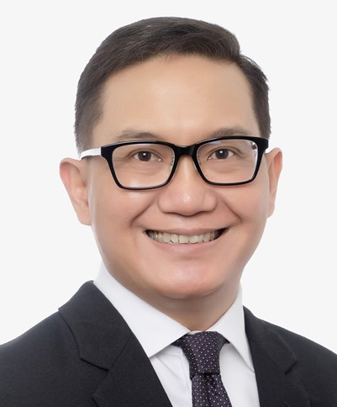
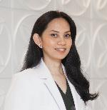
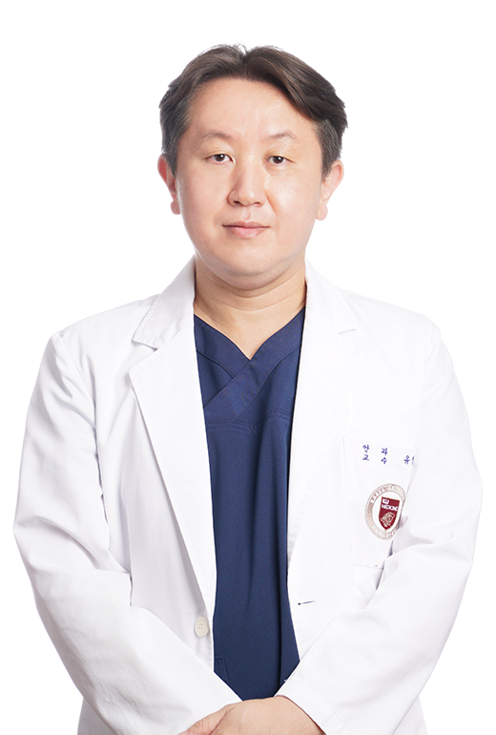
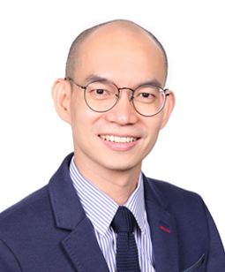

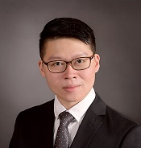


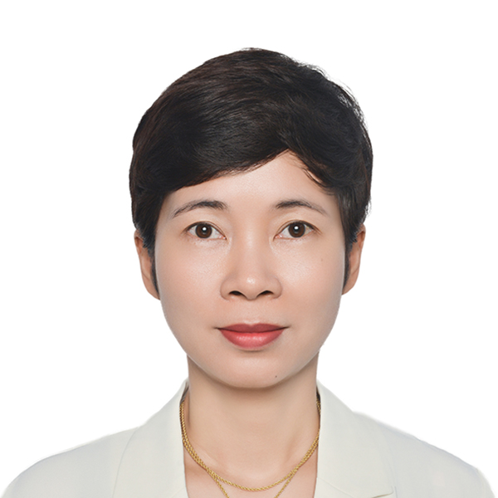
GLOW meeting expert advisors
Meeting Chairperson
Prof. Joseph Anthony Tumbocon
St. Luke’s Medical Center Quezon City
Philippines
Dr. Astrianda Nadya Suryono
RSCM Jakarta
Indonesia
Prof. Chungkwon Yoo
Korea University Anam Hospital
South Korea
Dr. Gan Eng Hui
International Specialist Eye Center
Malaysia
Cornea Specialist
(Guest Advisor)
Assoc. Prof. Vilavun Puangsricharern
Chulalongkorn University
Thailand
Dr. Low Jin Rong
Cornerstone Eye Centre
Singapore
Dr. Chien-Chia Su
National Taiwan
University Hospital
Taiwan
Assoc. Prof. Manchima Makornwattana
Thammasat University
Thailand
Dr. Pham Thi Thu Ha
National Eye Hospital
Vietnam

Slide 28


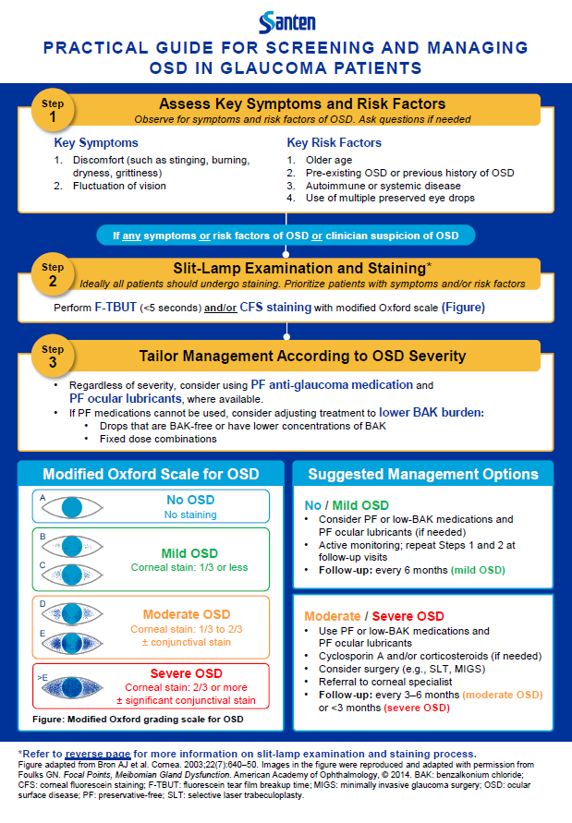
OSD Practical Guide development timeline
Apr–Jun 2025
Expert review and development of the OSD Practical Guide monograph
8th Mar 2025
Jul–Dec 2025
GLOW Meeting
Development of additional
OSD Practical Guide materials
(slide deck and videos)
GLOW: Glaucoma and Ocular Surface Disease Practical Approaches – An Asia Expert Working Group; OSD: ocular surface disease.

Slide 29
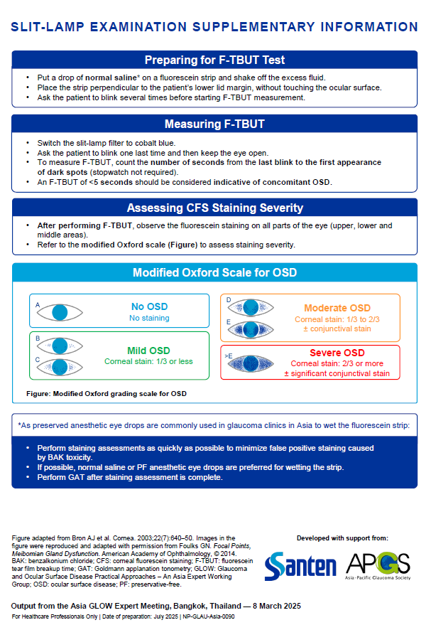
An expert-led, Asia-specific OSD Practical Guide
Simple 3-step approach to screening and managing OSD in glaucoma patients
Intended to represent the collective practices of ophthalmologists in Asia
Provides guidance from experts with flexibility to adapt according to local clinic settings
OSD: ocular surface disease.

Slide 30
Step 1: Assess key symptoms and risk factors
Step
1
Assess Key Symptoms and Risk Factors
Observe patient for key symptoms and risk factors of OSD, ask questions if needed
Key Symptoms | Key Risk Factors
Discomfort (such as stinging, burning, dryness, grittiness) Fluctuation of vision | Older age Pre-existing OSD or previous history of OSD Autoimmune or systemic disease Use of multiple preserved eye drops
If patient shows any symptoms or risk factors of OSD or clinician suspicion of OSD, proceed to Step 2
OSD: ocular surface disease.

Slide 31
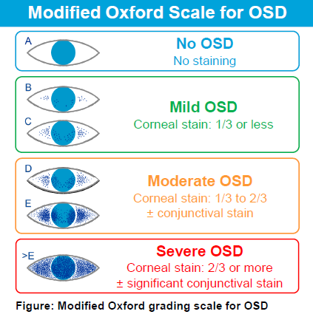
Step 2: Slit-lamp examination and staining
Step
2
Slit-Lamp Examination and Staining
Ideally all patients should undergo staining, but prioritize those with symptoms and/or risk factors
Perform F-TBUT (<5 seconds indicates OSD risk) and/or CFS staining with Modified Oxford scale
CFS: corneal fluorescein staining; F-TBUT: fluorescein tear film breakup time; OSD: ocular surface disease.

Slide 32
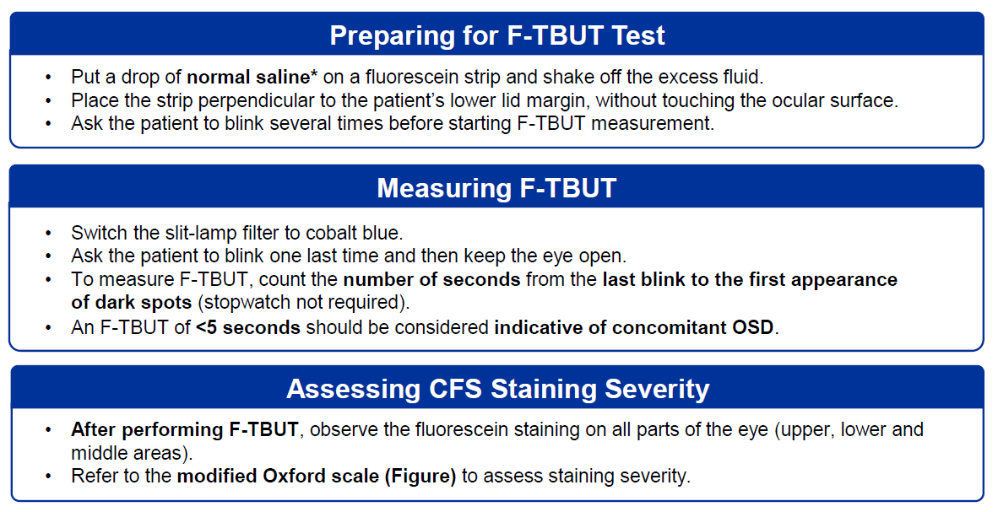
Step 2: Supplementary information (F-TBUT and CFS)
Supplementary information on preparing and performing F-TBUT and CFS are on the reverse page of the guide
CFS: corneal fluorescein staining; F-TBUT: fluorescein tear film breakup time; OSD: ocular surface disease.

Slide 33
Step 2: Supplementary information (anesthetic eye drops)
If preserved anesthetic eye drops are used for fluorescein staining in your clinic:
Perform staining assessments as quickly as possible to minimize false positive staining caused by BAK toxicity
If possible, normal saline or PF anesthetic eye drops are preferred for wetting the strip
Perform GAT after staining assessment is complete
BAK: benzalkonium chloride; GAT: Goldmann applanation tonometry; PF: preservative-free.

Slide 34
Step 3: Tailor management according to OSD severity
Step
3
Tailor Management According to OSD Severity
Tailor Management According to OSD Severity
Regardless of severity, consider using PF anti-glaucoma medication and PF ocular lubricants, where available.
If PF medications cannot be used, consider adjusting treatment to lower BAK burden:
  Drops that are BAK-free or have lower concentrations of BAK
  Fixed dose combinations
BAK: benzalkonium chloride; PF: preservative-free; OSD: ocular surface disease.

Slide 35
Step 3: Tailor management according to OSD severity
Step
3
Tailor Management According to OSD Severity
Suggested management options according to OSD severity:
No / Mild OSD
Consider PF or low-BAK medications and PF ocular lubricants (if needed)
Active monitoring; repeat Steps 1 and 2 at follow-up visits
Follow-up: every 6 months (mild OSD)
Moderate / Severe OSD
Use PF or low-BAK medications and PF ocular lubricants
Cyclosporin A and/or corticosteroids (if needed)
Consider surgery (e.g., SLT, MIGS)
Referral to corneal specialist
Follow-up: every 3–6 months (moderate OSD)
or <3 months (severe OSD)
PF: preservative-free; MIGS: minimally invasive glaucoma surgery; OSD: ocular surface disease; SLT: selective laser trabeculoplasty.

Slide 36
Summary of OSD Practical Guide
Step
1
Observe for key symptoms and risk factors,
ask questions if needed
Assess Key Symptoms and Risk Factors
Step
2
Perform F-TBUT (<5 seconds) and/or CFS staining with modified Oxford scale
Slit-Lamp Examination and Staining
Step
3
Consider PF formulations or reduce BAK where possible; tailor management and follow-up according to OSD severity grade
Tailor Management According to OSD Severity
Supplementary information on F-TBUT and CFS is available on the reverse page of the guide
BAK: benzalkonium chloride; CFS: corneal fluorescein staining; F-TBUT: fluorescein tear film breakup time; PF: preservative-free;
OSD: ocular surface disease.

Slide 37
This section provides a template and guidance to structure a patient case presentation. Please note that using template slides is optional, and you should feel free to present your case as you see fit.​
4
Patient Case Study Template

Slide 38
Guidance notes
Please delete these guidance notes when using the case study template slides
Clinical relevance: Ensure that the case selected offers significant clinical or learning value and is not just an isolated or rare event without broader implications
Reference data: When mentioning treatments, drugs, or procedures, please reference the relevant clinical guidelines or research data that influenced the decision-making process
Avoid bias: Ensure that the case presentation is objective and does not favor any particular drug, treatment, or procedure unless backed by evidence. Avoid making promotional or
biased statements
Confidentiality: No patient information that could allow identification of individuals should
be included
Structure: Ideally, slides will be a mix of text and illustrative images; the following slides provide an outline structure to guide the preparation of your patient case. Please include relevant questions that you believe need to be discussed during the clinical case sharing

Slide 39
Patient consent
Please delete these guidance notes when using the case study template slides
Before completing the case study template, please confirm:​
You have obtained consent from the patient for their data to be included​
      It is important that you explain (if appropriate) that confidentiality will be maintained, and that no non-essential identifiable information will be included​
      Where appropriate, we advise that you document the consent and provide this alongside your case study​
      It is not only important but also, in most cases, legally necessary to obtain consent​
      Remember that the patient has the right to refuse, and this should be respected​
All patient information included in the case study should be anonymized​
      Personal data include, but is not limited to, the patient’s name, initials, or date of birth, as well as identifiable photos ​(note: distinctive features must be obscured)​

Slide 40
Template for case studies​
Please delete these guidance notes when using the case study template slides
Template slides have been provided for use in your presentation ​
The purpose of providing this template is to maximize consistency between case presentations and ensure a cohesive experience for the audience
Please note that case template slides are optional – speakers are free to structure their case presentations in their own way and are not expected to use every slide
Please see the slide notes for further guidance on the use of each slide template

Slide 41






Patient case history
Briefly describe the key patient characteristics
Age
Text here
Medical history
Text here
Sex
Text here
Ethnicity
Text here
Symptoms at initial presentation (including key problems)
Text here
Occupation
Text here
<Footnotes>
Notes:
Please include any information that is relevant to the clinical management of the patient. ​Please describe patient symptoms that led the patient to consult their physician.
Previous medical history, including family history, comorbidities, prior medication use, prior eye injury or surgery, and any other information relevant to treatment decisions​
Symptoms at initial presentation, including stinging, burning, or scratchy sensation in the eye(s), stringy mucus in or around the eyes, sensitivity to light, eye pain or pressure, headaches, low vision, blurred vision, tunnel vision, or blind spots, nausea and vomiting, red eyes

Slide 42
Diagnostic imaging and assessment
Briefly describe the diagnosis methods undertaken
<Footnotes>

Slide 43
Diagnostic imaging and assessment
Include images from diagnostic assessments that you may wish to highlight
Placeholder for image
Placeholder for image
<Insert relevant dates, key findings,
and complementary measurements here>
<Insert relevant dates, key findings,
and complementary measurements here>
<Footnotes>

Slide 44
Diagnosis
Summarize the diagnosis based on the diagnostics examinations and tests
A problem list should be included to support the management plan
<Footnotes>

Slide 45

Treatment and management
Describe the first-line treatment that was administered and any subsequent treatments
Treatment administered
Management of AEs
Treatment response
Change in therapy
<Footnotes>
AE: adverse event.
Notes:
Describe the first-line treatment that was administered and any subsequent treatments
Treatment administered (eye drops/laser/surgery), including the reason for treatment selection
Treatment response, including any relevant assessment measures, notable adverse events, and quality of life
Change in therapy, including dosage, reason for change - e.g. tolerability, safety, treatment target not reached, patient preference, etc

Slide 46
Treatment outcomes and follow-up
Include images of treatment outcomes that you may wish to highlight
Guide: Treatment outcomes relevant to the case, such as IOP, OSD assessment, visual field, OCT, treatment adherence, adverse events, and other patient outcomes.
Placeholder for image
Placeholder for image
<Insert relevant dates, key findings,
and complementary measurements here>
<Insert relevant dates, key findings,
and complementary measurements here>
<Footnotes>

Slide 47
Patient treatment journey timeline
Include details of patient treatment journey along with dates and important information
Assessment
Diagnosis
Initial treatment
Subsequent treatment
Subsequent treatment
Patient follow-up/ treatment response
Date:
Additional information:
Change in treatment (drug name,
dosing regimen)
Date:
Additional information:
Change in treatment (drug name,
dosing regimen)
Date:
Additional information:
Patient presentation
Date:
Additional information:
Diagnosis
Date:
Additional information:
First-line
treatment prescribed (drug name,
dosing regimen)
Date:
Additional information:
Diagnostic assessment
Date:
Additional information:
Disease monitoring assessments
Date:
Additional information:
Patient follow-up/ treatment response
Date:
Additional information:
Patient follow-up/ treatment response
Date:
Additional information:
<Footnotes>

Slide 48
Additional information or images
Please provide any additional information that you believe may be relevant for inclusion in the case study.
<Footnotes>

Slide 49

Summary
1
Insert message
2
Insert message
3
Insert message
Key takeaway
Text here
<Footnotes>

Slide 50
Example icon styles

Slide 51
Developed with support from:

